Slide 1


Project Group # III
Sprint 0

Slide 2

About The Project
This Photo by Unknown author is licensed under CC BY-SA.

Slide 3
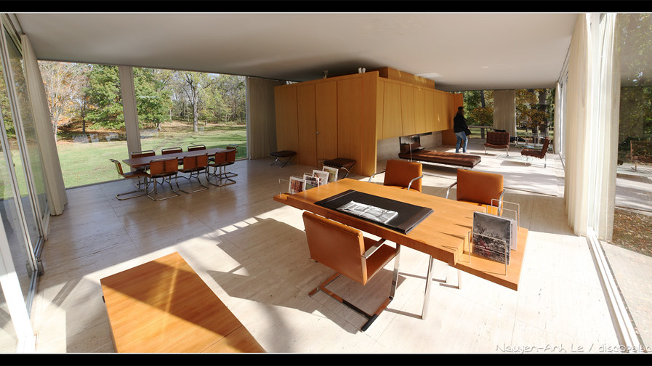
Automatic Indoor Climate Control System for a living space.
I.e. - a house or an apartment
This Photo by Unknown author is licensed under CC BY-NC-ND.

Slide 4

Team Goal

Slide 5

A fully functionate system guided by our customers needs and wishes .

Slide 6

Features

Slide 7

Simulated Ventilation Box
Automatic & Manual Room Climate Controls
Sensor Database and Cloud Availability
User-Interface Touch Panel for Room Controls
This Photo by Unknown author is licensed under CC BY.

Slide 8

Planning For Next Sprint

Slide 9

Functionality of all Sensors
System Design Document
Communication Protocol Design
Sprint Goals

Slide 10

Retrospective

Slide 11

Things that went well:
Team Talks
Availability of members
Discussions with the client
Setting-up discussions
New way of managing Version Control & Scrum Board
Things that need to be improved:
Dedication at certain times
Effort of the group
Communication
Not overcomplicating

